Slide 1
Text Analytics Assignment 02
Lexicon and Naïve - Bayesian Spam Filter
Submitted by
Malathi M

Slide 2
OBJECTIVE
To build a “Spam Filter” using given lexicons(Affin dataset) and also Naïve Bayesian model for the same.

Slide 3
DATA PIPE LINE
1.1.
1.1.
1.1.
1.1.
Reading Datasets
1.Explore
2.Head
3.Tail
4.Info of the given dataset
Pre-Processing
1.Stop Word Removal
2.Normalization
3. Dummy Coding
4. Shuffling of rows in Data Frame.
5.Splitting data into Test and Train
6. Tokenization of Test and Train dataset
Model
1.Naïve Bayes Spam Filter Model using scikit-learn
2.Lexicon based model
3.Model build using TextBlob Naïve Bayes Classifier
Conclusion
1.Discussion and Conclusion of outcomes from each model.

Slide 4
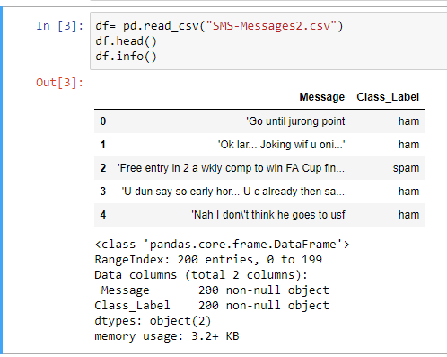
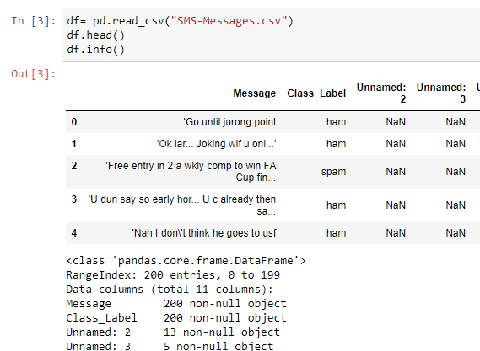
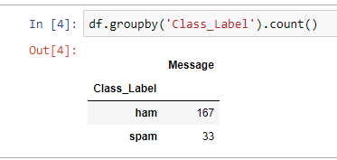
Node1-Reading Dataset
1.Given Datasets[‘SMS-Messages2’ and ‘SMS-Messages’] are set of message with class label attached with them as ‘Ham’ or ‘spam’ . Total number of messages were 200 and two datasets are similar.
2.Each Class count in the given sets are :

Slide 5
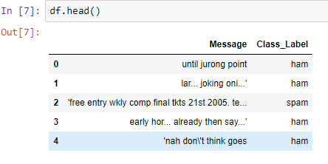
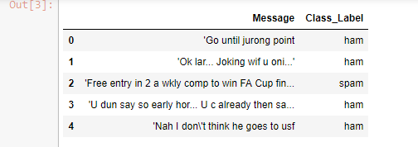
Node2-Pre-Processing
1.Stop Word removal is done, words which are having letters less than or equal to three are removed and normalization(converting all words to lower case to make words case insensitive) of each sentences are done.
2.Dumming coding for class labels are done as “Ham= 0” and “Spam = 1” for modelling purpose.
3.Shuffling of the rows in the data frame are done for reducing bias in the outcome if there are any.
After Normalization and Stop Word Removal
Before Normalization and Stop Word Removal

Slide 6
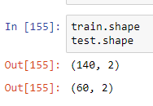
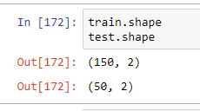
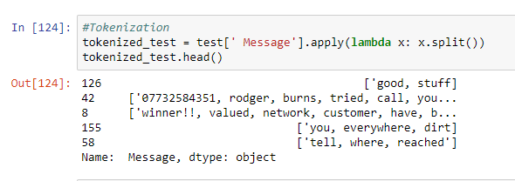
Node2-Pre-Processing
4.Splitting the data frame into test and train with 70:30 ratio for SMS-Messages data and 75:25 ratio for SMS-Messages2 data.
5.Finally, Tokenization of each sentence is done at word level for test and train datasets.
Size of test and train dataset for SMS-Messages data.
Size of test and train dataset for SMS-Messages2 data.
Tokenized sentence at word level.

Slide 7
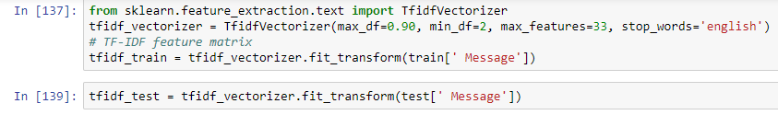
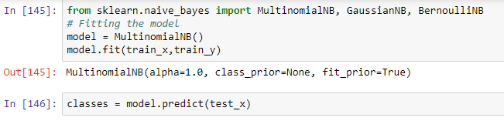
Node3- Model
Model-1 Naïve Bayes from scikit-learn:
Creating Tfidf vectors for each test and train dataset with max_df =90%, min_df = 2 and max_features = 33 for Messages2 data and max_features = 32 for Messages data.
max_df and min_df = ignores the terms which appears more and less respectively according to the given value.
Max_features are the maximun features selected for modelling, here the numbers are selected based on the maximum features available in the test dataset as it will always have less features than train dataset.
Tfidf Vectorization
Fitting and Predicting on test and train dataset respectively.

Slide 8
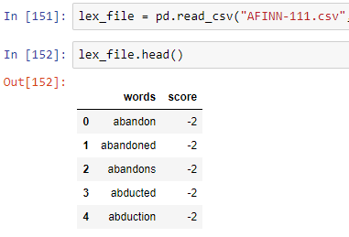
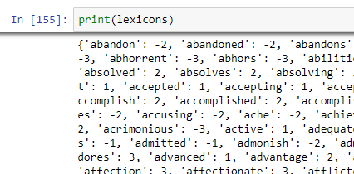
Node3- Model
Model-2 Lexicon Based Model:
Importing and creating as a standard lexicon file (Affin Dataset).
Scoring each sentence(Tokenized list of each sentence) of test datasets by words using the lexicon file.
If the score is greater than or equal to zero then the message is considered as ham or else spam.
Here we can train the dataset and then test, directly we are modelling on test dataset and comparing the accuracy with other models.
Affin Dataset as Dataframe
Affin Dataset as Dictionary

Slide 9
Node3- Model
Model-3 Textblob Naïve Bayes Classifier:
Textblob Classifier is a simple classifier where the train dataset(list of tuples) is fitted to train the model and accuracy of the classification can be obtained.
Then the test dataset is passed to into textblob classifier and can obtain the accuracy of the classification.
Textblob classifier will also show the informative features where the each word is scored and the occurrence of the word in a sentence will help in classification of the sentence based on the weightage given to the word.

Slide 10
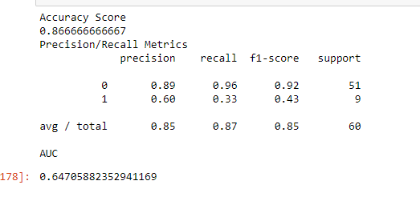
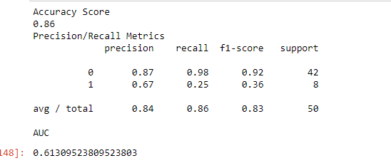
Node 4 – Discussion
Model-1 Outcome of Naïve Bayes from scikit-learn(1):
1.Accuracy for both the models are almost same, but recall value for classification of spam is grater for Messages(33%) dataset where the ration for test and train is 70:30. Here t is clearly know that the randomness in sample and number of documents for test plays an important role for producing results.
2.Area Under Curve value is also high for Messages dataset. i.e.,64.70%
Precision and Recall Values for Messages2 dataset
Precision and Recall Values for Messages dataset

Slide 11
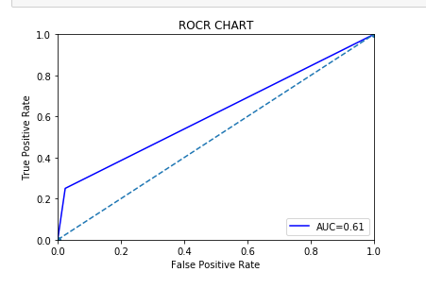
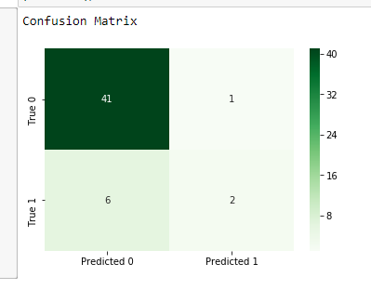
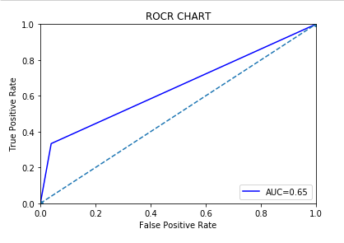
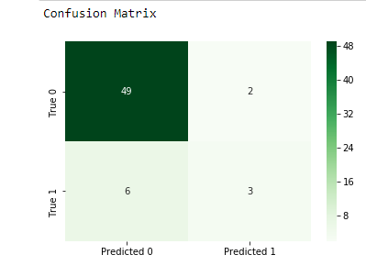
Node 4 – Discussion
Model-1 Outcome of Naïve Bayes from scikit-learn(2):
Confusion Matrix and ROC curve for Messages2 dataset
Confusion Matrix and ROC curve for Messages dataset

Slide 12
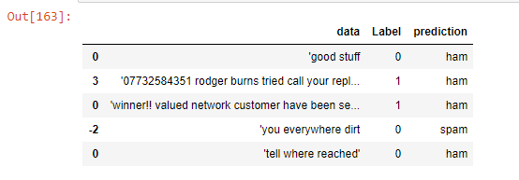
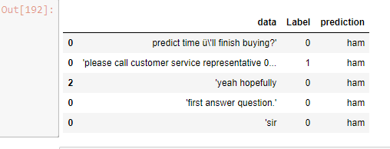
Node 4 – Discussion
Model-2 Outcome of Lexicon Based Model (1):
1.Above picture is a dataframe with strength for each sentence on first column and prediction of each sentence last column.
Outcome Dataframe for Messages2 dataset
Outcome Dataframe for Messages dataset

Slide 13
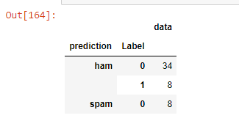
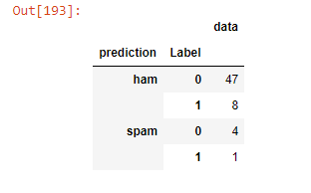
Node 4 – Discussion
Model-2 Outcome of Lexicon Based Model(2):
1.Accuracy for Messages2 dataset is 68% and for Messages is 80%.
2.True negative value i.e., Model able to detect spam message in Messages2 dataset is “Zero” and for Messages is 20%.
Pivot Table for Messages2 dataset
Pivot Table for Messages dataset

Slide 14
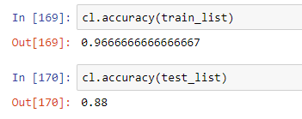
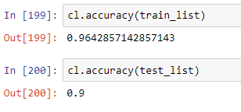
Node 4 – Discussion
Model-3 Textblob Naïve Bayes Classifier(1):
1.Accuracy of test dataset for Messages id greater than Messages2.
Test and Train Accuracy for Messages2 dataset
Test and Train for Messages dataset

Slide 15
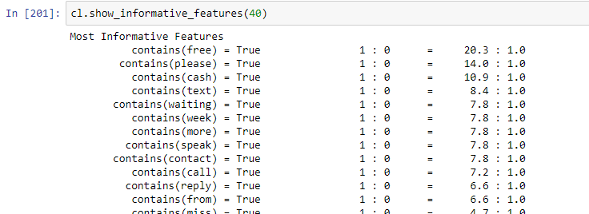
Node 4 – Discussion
Model-3 Textblob Naïve Bayes Classifier(2):
1.Informative Features give the idea that the sentence having word free may be spam cause the weightage for this word is high.
2.Similary if the weightage for the given word is high for ham the sentence is most likely to be classified as ham.
Informative Features for Messages dataset

Slide 16
Node 4 – Conclusion
Conclusion of Models:
1.If the accuracy is taken into account then the Textblob naïve Bayes classifier is most likely to be a good model to classify or to create a spam filter.
2.And also Textblob Classifier gives weightage for each word likely to be ham or spam.
3.Naïve Bayes from scikit learn and Lexicon based models were able to filter spam messages by 33% and 20% respectively for Messages dataset and 25% and 0% for Messages2 dataset.
4.Instead of Tfidf, Bag of words model for Naïve Bayes from scikit learn can be built.
Demerits of Textblob classifier:
1.Draw back of the texblob classifier is that, we can know the recall value and true negative rate for the model build.
Other Points:
1. Outcome are likely to be affected by random sampling and ratio of test and train datasets.

Slide 17
GitHub Link:
https://github.com/MalathiMuniraju/hello-world/blob/master/Text%20Analytics.pptx
THANK YOU

